Slide 1
Problem solving with plotting coordinates
Plotting coordinates

Slide 2
how to use Oak lessons

Slide 3
I can use my knowledge of plotting coordinates to solve problems.

Slide 4
Drawing on a graph or map is known as plotting.

Slide 5

Problem solving with plotting coordinates
Calculating horizontal and vertical distance
Finding the coordinates where two lines intersect

Slide 6
Calculating horizontal and vertical distance
We can use our knowledge of properties of shape to solve shape problems with coordinates.
What shape have I drawn below?
Rectangle
How do you know?
Opposite sides are the same length.
It has 4 right angles.

Slide 7
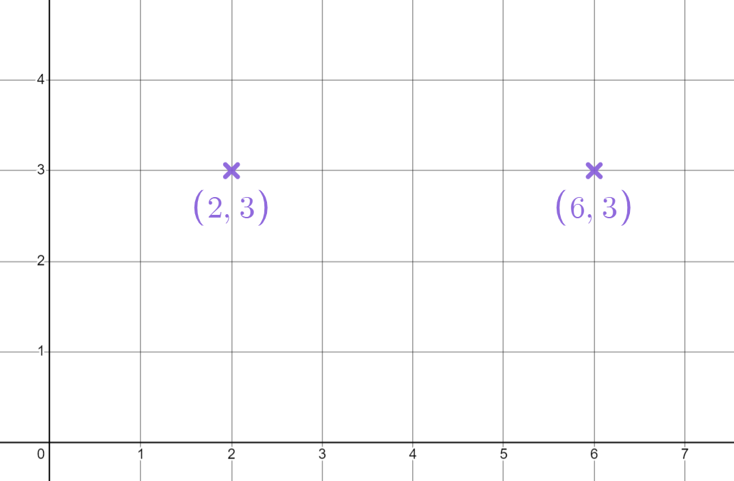
Calculating horizontal and vertical distance
We can calculate the horizontal and vertical distance between 2 coordinates to help us solve shape problems.
What is the distance between these coordinates?
They both have the same y values.
4
The x values have a difference of 4
(6 - 2 = 4)
The horizontal distance is 4

Slide 8
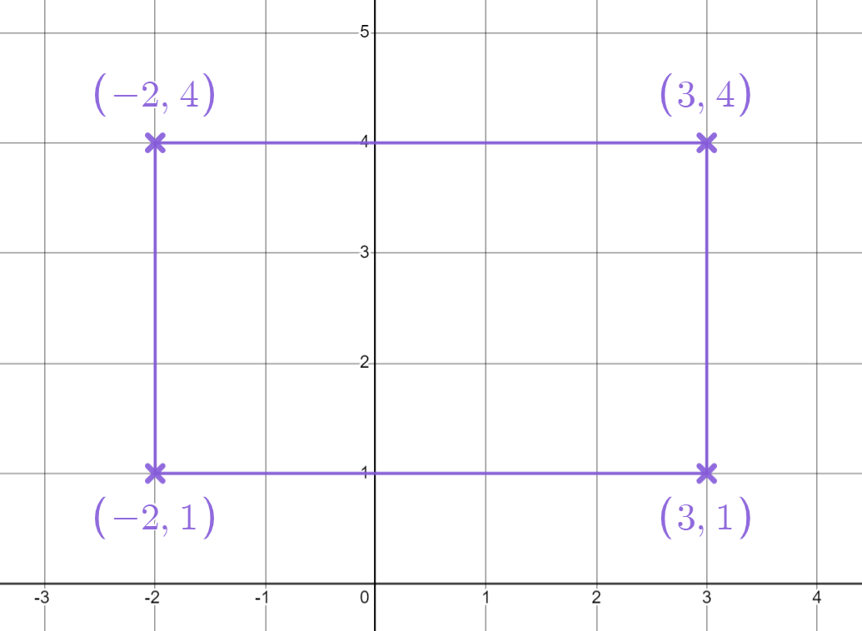
Calculating horizontal and vertical distance
What are the side lengths of this rectangle?
The vertical distance is the difference between 1 and 4
4 - 1 = 3
5
3
The horizontal distance is the difference between -2 and 3
3- (-2) = 5

Slide 9
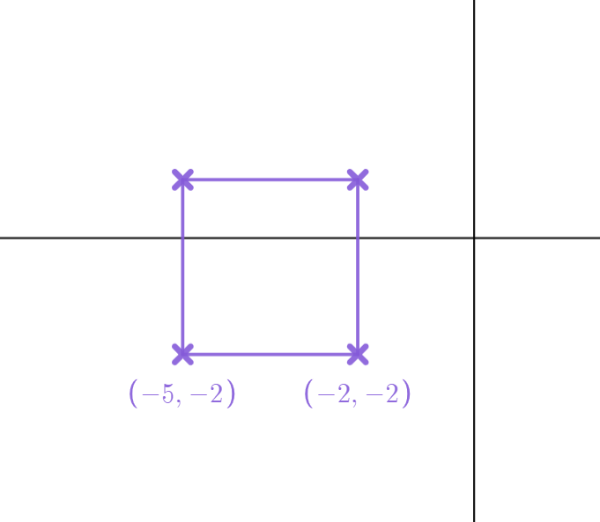
Calculating horizontal and vertical distance
This time the plotted shape is a square.
What properties does a square have?
All sides are the same length.
All angles are right angles.
What is the length of the side joining the two marked coordinates?
The y coordinates are the same.
3
The difference between the x coordinates is 3
-2 - (-5) = 3

Slide 10
Calculating horizontal and vertical distance
All sides of the square have length 3
We can use this to find the other 2 coordinates of the square.
For the top left coordinate:
The x value is -5
1
(-5, )
(-2, 1)
3
The y value is -2 + 3 = 1
3
3
For the top right coordinate:
The x value is -2
The y value is 1
3

Slide 11
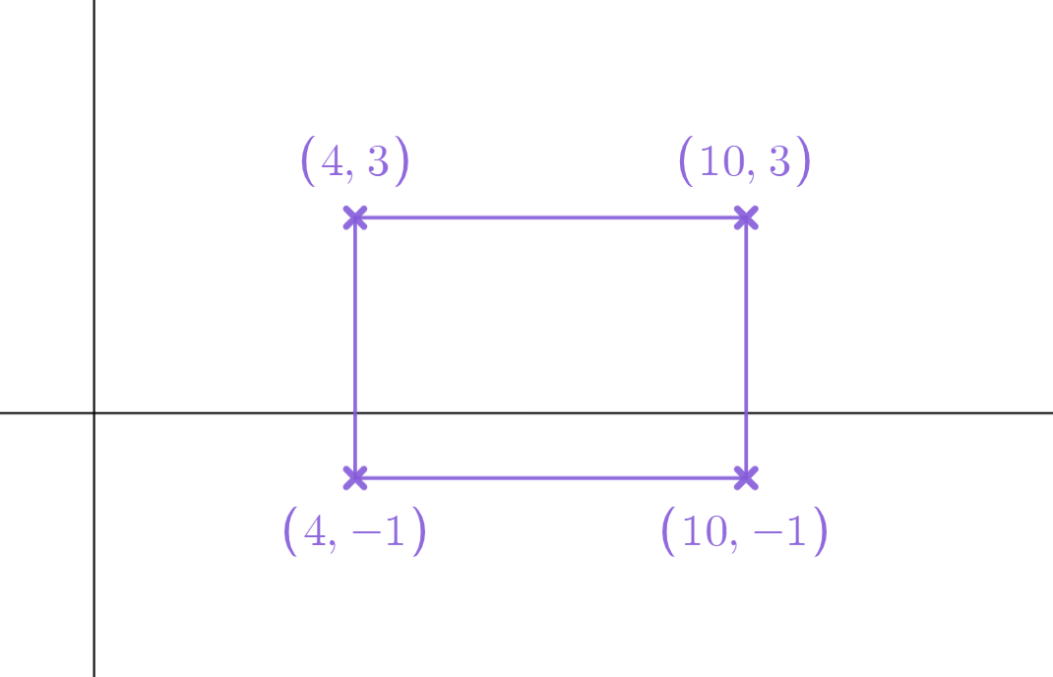
Calculating horizontal and vertical distance
What are the side lengths of this rectangle?
10 - 4 = 6
Horizontal sides have length 6
6
4
3 - (-1) = 4
Vertical sides have length 4

Slide 12
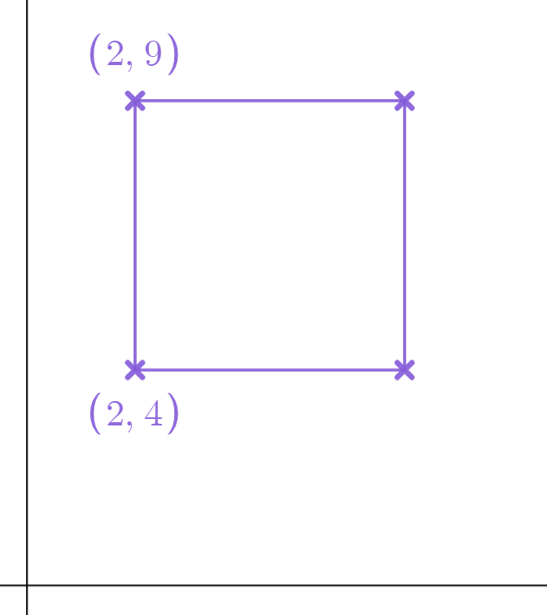
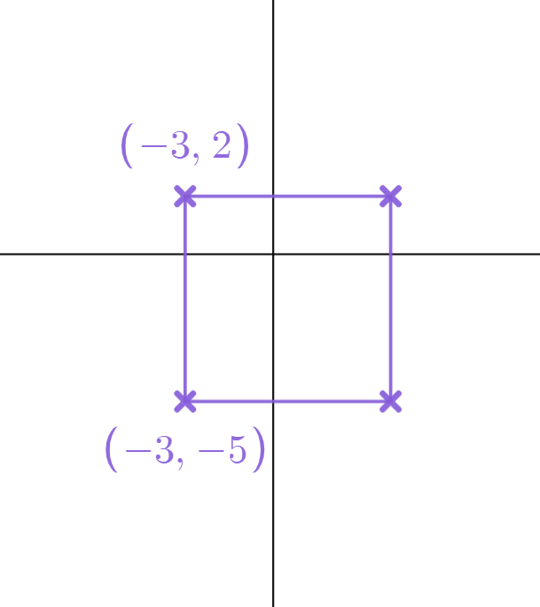
Calculating horizontal and vertical distance
Work out the missing coordinates to make each shape a square.
a)
b)
( , )
( , )
( , )
( , )

Slide 13
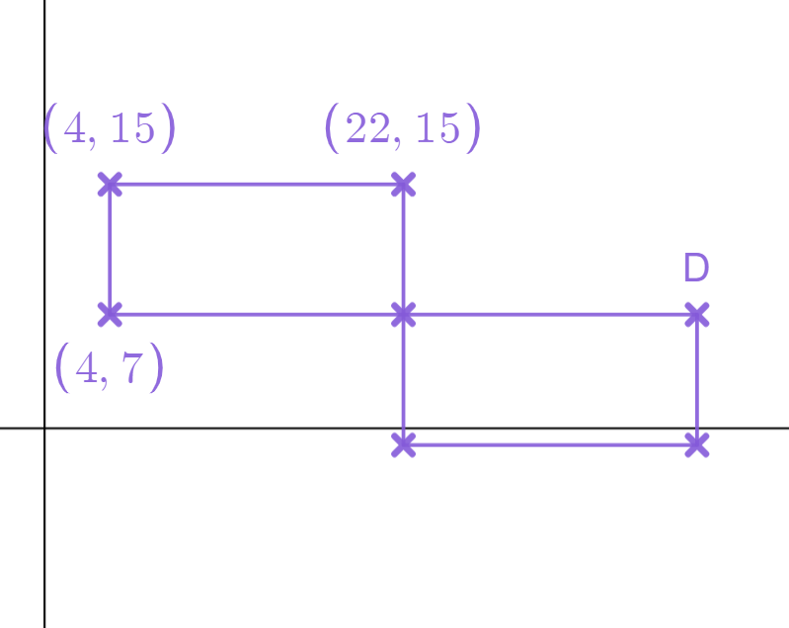
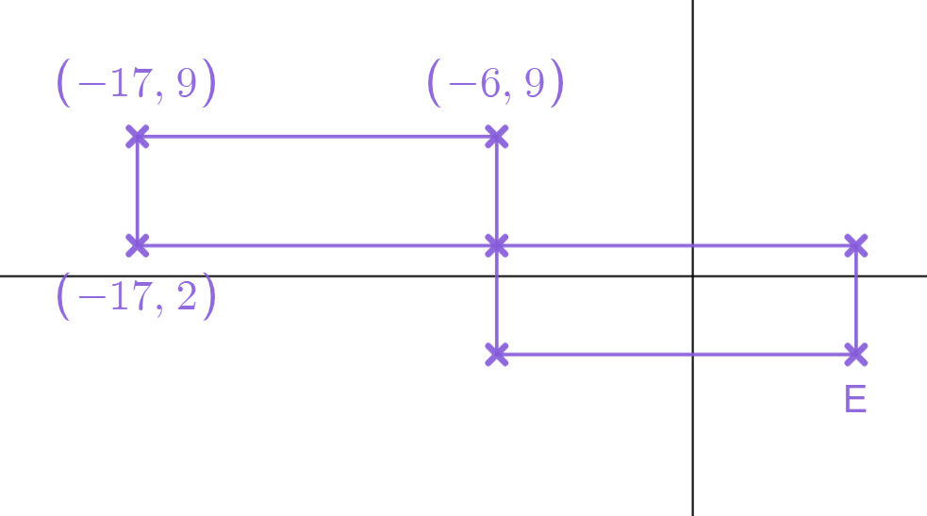
Calculating horizontal and vertical distance
2a) These two rectangles are the same size. Work out the missing coordinate D.
2b) These two rectangles are the same size. Work out the missing coordinate E.
( , )
( , )

Slide 14
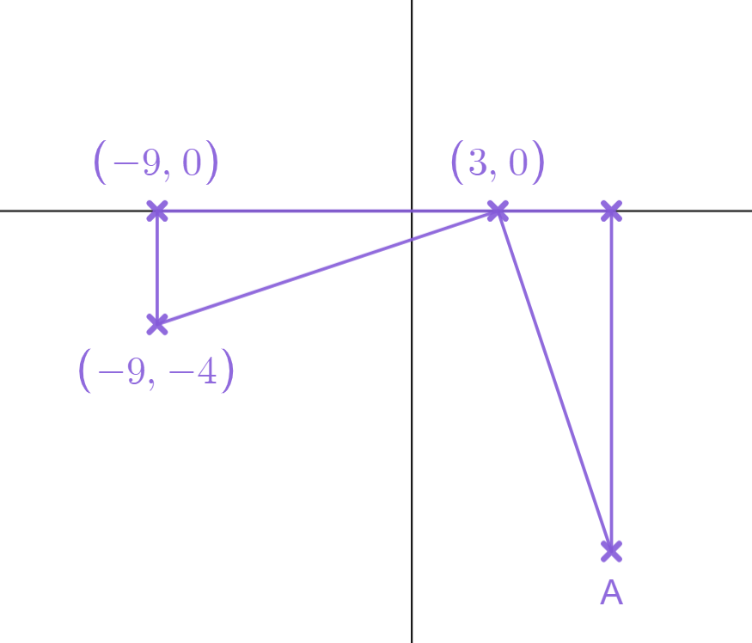
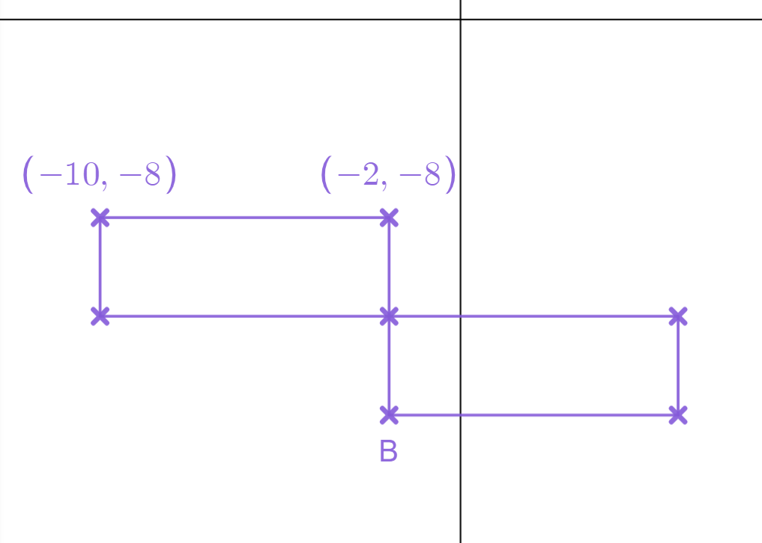
Calculating horizontal and vertical distance
2c) These two rectangles are the same size. The length is double the width. Work out the missing coordinate B.
2d) Below are two identical triangles. Work out the missing coordinate A.
( , )
( , )

Slide 15
Calculating horizontal and vertical distance
Work out the missing coordinates to make each shape a square.
a)
b)
5
(7,9)
(4,2)
7
5
7
(7,4)
(4,-5)

Slide 16
Calculating horizontal and vertical distance
2a) These two rectangles are the same size. Work out the missing coordinate D.
2b) These two rectangles are the same size. Work out the missing coordinate E.
11
18
7
11
(5,2)
(40,7)
18
7
(5,-5)

Slide 17
Calculating horizontal and vertical distance
2c) These two rectangles are the same size. The length is double the width. Work out the missing coordinate B.
2d) Below are two identical triangles. Work out the missing coordinate A.
12
4
(7,0)
8
4
4
12
4
(-2,-16)
(7,-12)

Slide 18
Problem solving with plotting coordinates
Calculating horizontal and vertical distance
Finding the coordinates where two lines intersect

Slide 19


Finding the coordinates where two lines intersect
We can find where 2 lines intersect by finding a coordinate that follows the rules of both lines.
Here are some coordinates that
follow
the rule
(2,-5) (2,-1) (2,0) (2,3) (2,6)
All these coordinates will sit on a line
that we call
Which of these coordinates also follows
the rule
?
(2,3)

Slide 20
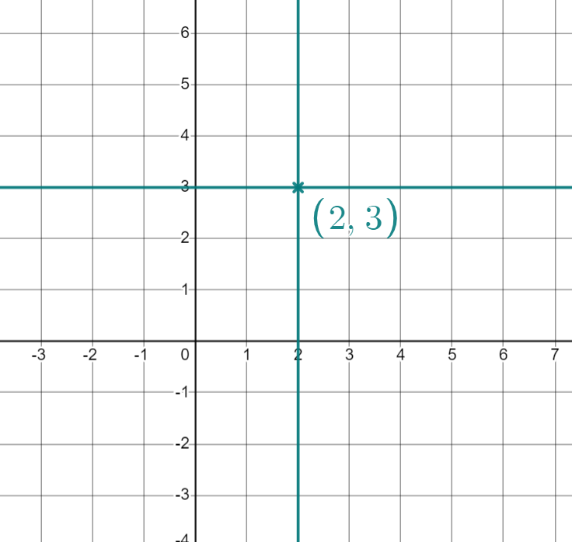
Finding the coordinates where two lines intersect
The coordinate (2,3) will be on the
line
and
That means the 2 lines will intersect (cross over) at this coordinate.

Slide 21

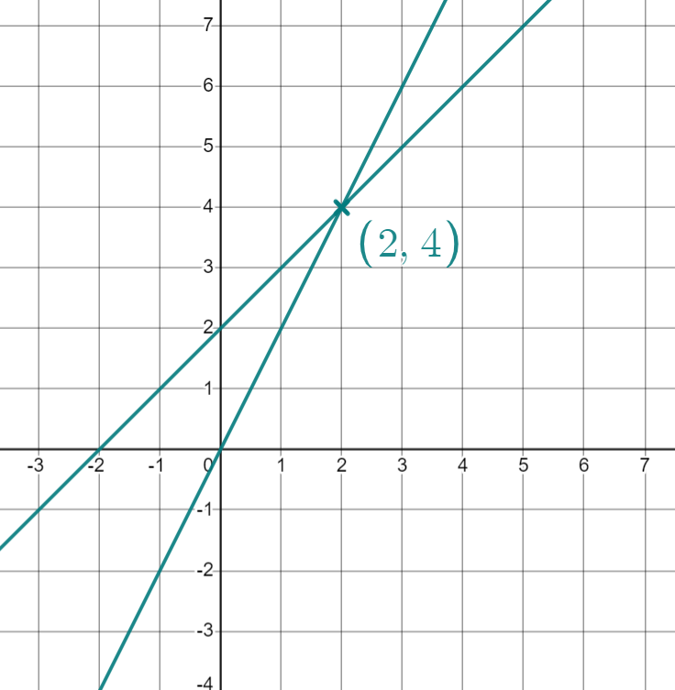

Finding the coordinates where two lines intersect
Suggest some coordinates that are on
the line
E.g. (-4,-2) (-2,0) (1,3) (2,4) (3,5)
Do any of these also follow
the rule
?
(2,4)
The lines
and
will intersect at (2,4)

Slide 22




Finding the coordinates where two lines intersect
Pick two rules which apply to the coordinate (4,6)

Slide 23


Finding the coordinates where two lines intersect
Pick two rules which apply to the coordinate (3,5)

Slide 24



Finding the coordinates where two lines intersect
Pick two rules which apply to the coordinate (-3,3)

Slide 25


Finding the coordinates where two lines intersect
Pick two rules which apply to the coordinate (-2,4)

Slide 26



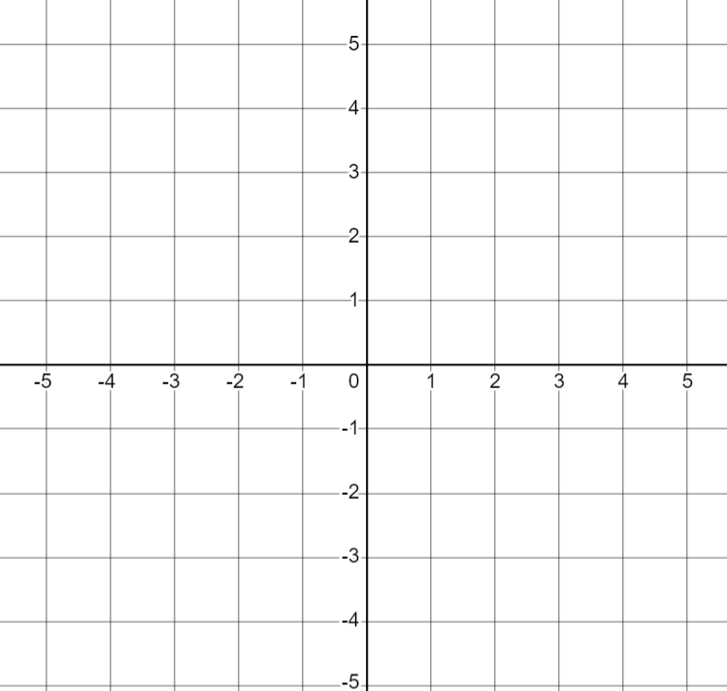
Finding the coordinates where two lines intersect
Find a coordinate that follows both rules. You may wish to use the axes to help.
a)
b)
c)

Slide 27



Finding the coordinates where two lines intersect
Find a coordinate that follows both rules. You may wish to use the axes to help.
d)
e)
f)

Slide 28






Finding the coordinates where two lines intersect
2) Where do each pair of lines intersect?
(list some coordinates that fit the rules to help you)
a)
b)
c)
d)
e)
f)

Slide 29




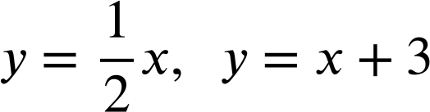
Finding the coordinates where two lines intersect
2) Where do each pair of lines intersect?
g)
h)
i)
j)
k)

Slide 30
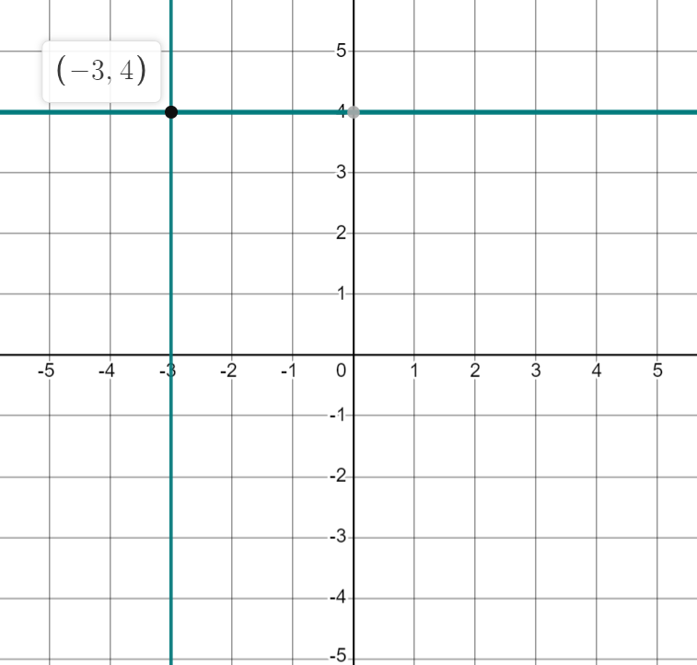
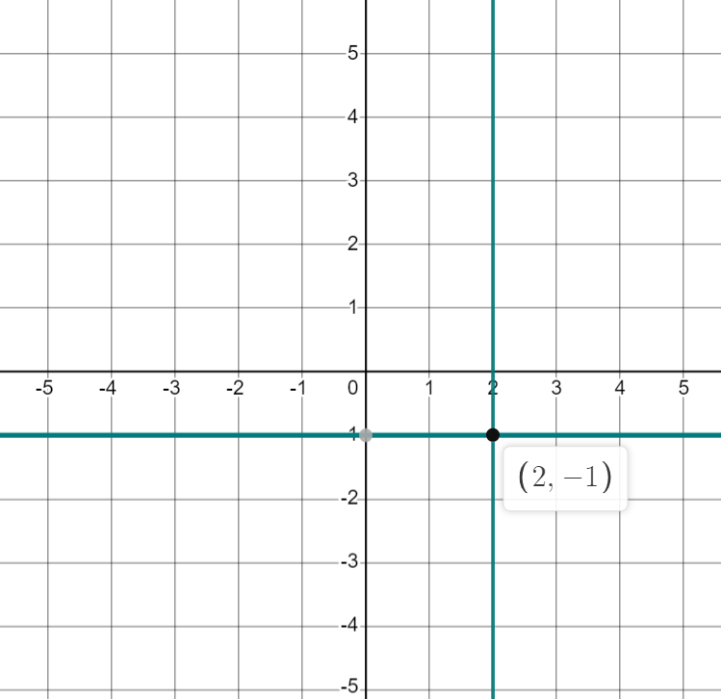
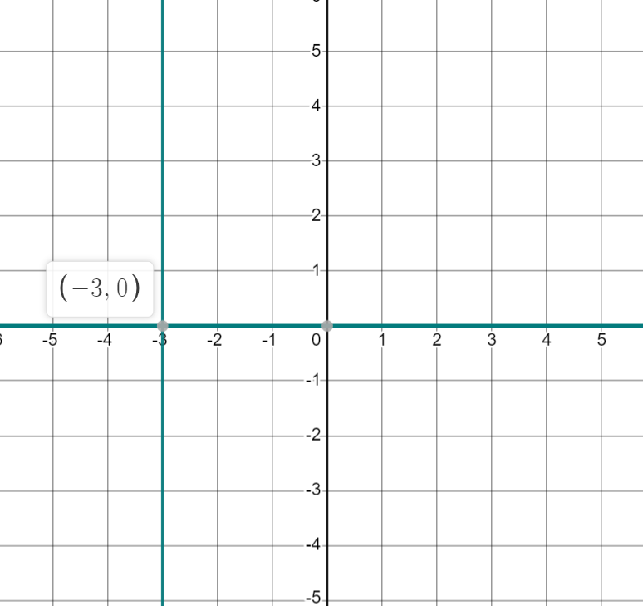
Finding the coordinates where two lines intersect
Find a coordinate that follows both rules. You may wish to use the axes to help.
a)
b)
c)
(-3,4)
(2,-1)
(-3,0)

Slide 31
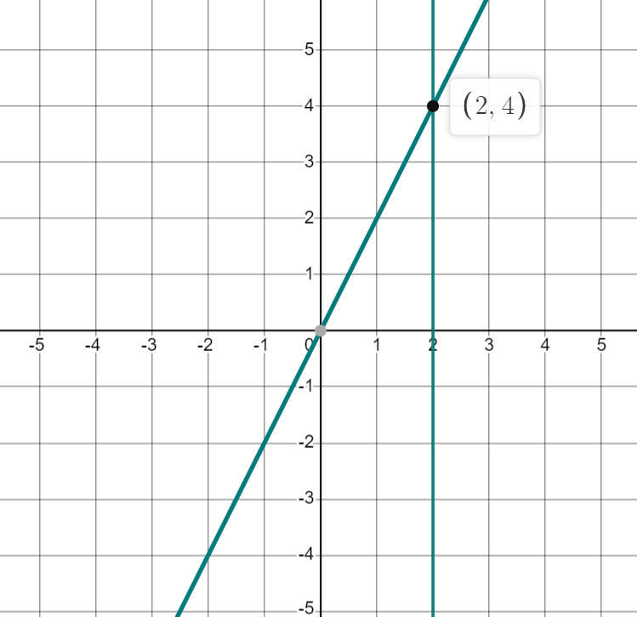
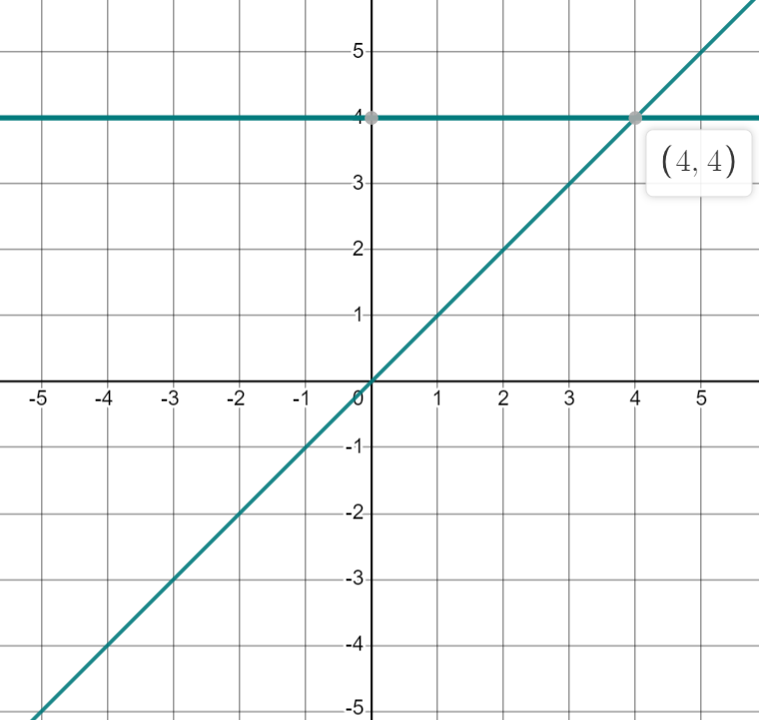
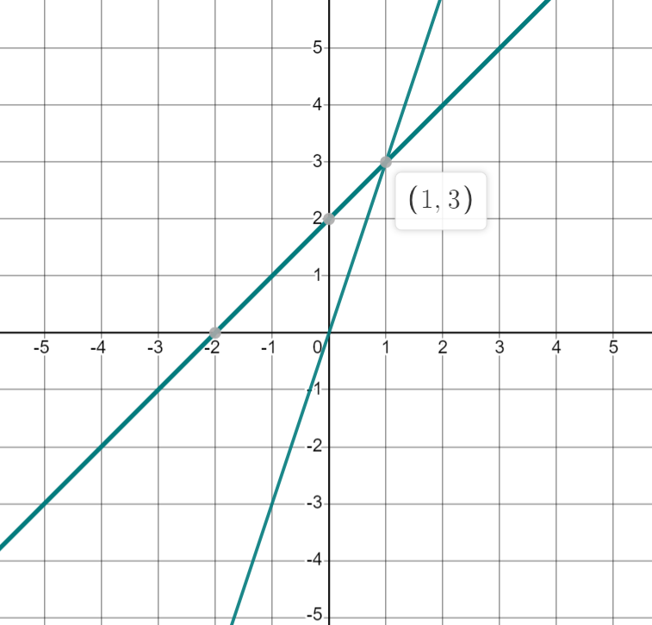
Finding the coordinates where two lines intersect
Find a coordinate that follows both rules. You may wish to use the axes to help.
d)
e)
f)
(2,4)
(4,4)
(1,3)

Slide 32
Finding the coordinates where two lines intersect
2) Where do each pair of lines intersect?
(list some coordinates that fit the rules to help you)
a)
b)
c)
d)
e)
f)
(4,9)
(1,2)
(3,6)
(5,10)
(-1,-2)
(0,0)

Slide 33
Finding the coordinates where two lines intersect
2) Where do each pair of lines intersect?
g)
h)
i)
j)
k)
(3,3)
(2,-2)
(-2,2)
(2,8)
(-6,-3)

Slide 34
Problem solving with plotting coordinates
We can work out the horizontal or vertical distance between coordinates.
We can find where two lines intersect by finding a coordinate that follows the rule of both lines.

Slide 35

© Oak National Academy 2023.
Produced in partnership with Mathematics in Education and Industry.
Licensed on the Open Government Licence v3.0, except where otherwise stated. See Oak terms and conditions.

